Slide 1
Isha Narola
As intern in software development

Slide 2
About me
I’m as an engineer student in Information technology 3rd year. I want to build up my skill and apply my education in industries and solve real life problem I applied in exposys data lab .Thank you for that to exposys data lab .
I am study in sarvajanik college of engineering and Technology .I am interesting in also to buiding new app and software.

Slide 3
WHAT IS BUILD?
Build app
Language
Translator
INPUT
ENGLISH LANGUAGE
OUTPUT
GUJARATI

Slide 4
LANGUAGE TRANSLATOR

Slide 5

English to Gujarati
Suppose , I am from gujarati Medium student till 12th std. After that , I am now study in engineering college,sometimes their are so difficult to understand some sentences and words also that time I need that language translator app
(supppose I want to build app from english to gujarati translator)
Translator app
(English to gujarati)

Slide 6
What to do in this app?
Input
English language (user enter text)
Output
Gujarati language
Translate btn(user get desired output)

Slide 7
App look like be!!

Slide 8
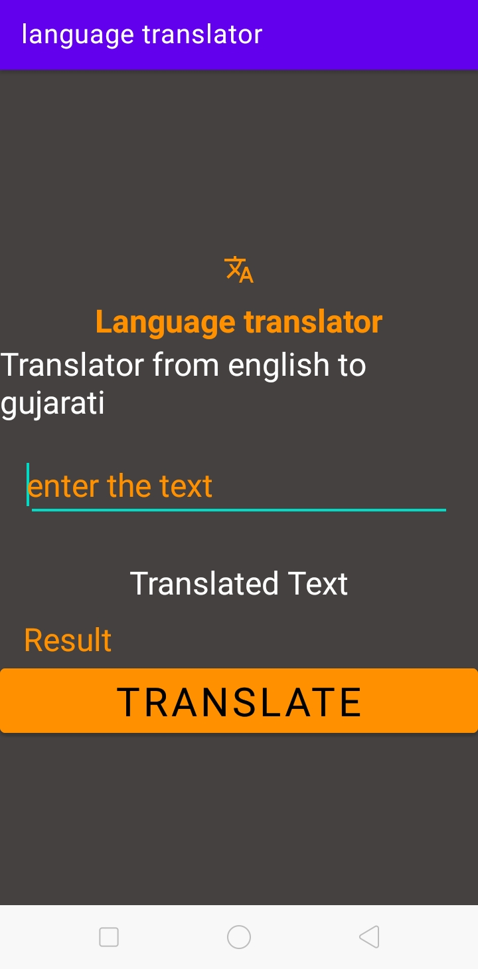
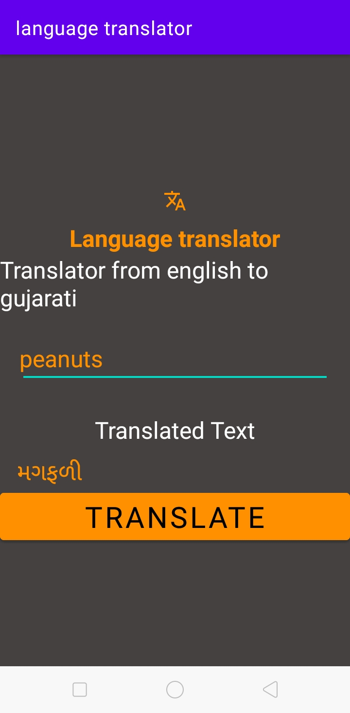
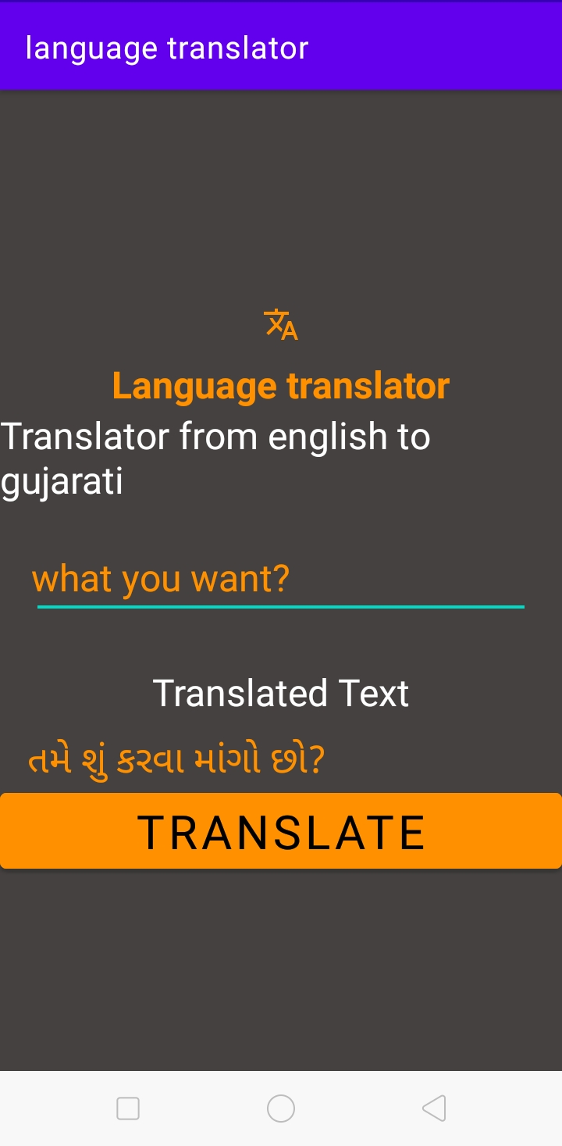

Slide 9

Contact
Isha Narola
If there are any question from your side then you can also mail me .
If you have any doubt then also you can contact me!
email:ishanarola123@gmail.com

Slide 10
Thank you!!!!!!!

